Slide 1


Worki project
Software Engineering project for Ariel University

Slide 2
Our application for managers of companies that interested in arranging and organizing shift schedules and sorting employees based on available space.

Slide 3
Manager Permission | Worker Permission
Watching online his shifts workers. | Watching co-workers of current user worker.
Adding workers to his company .

Slide 4

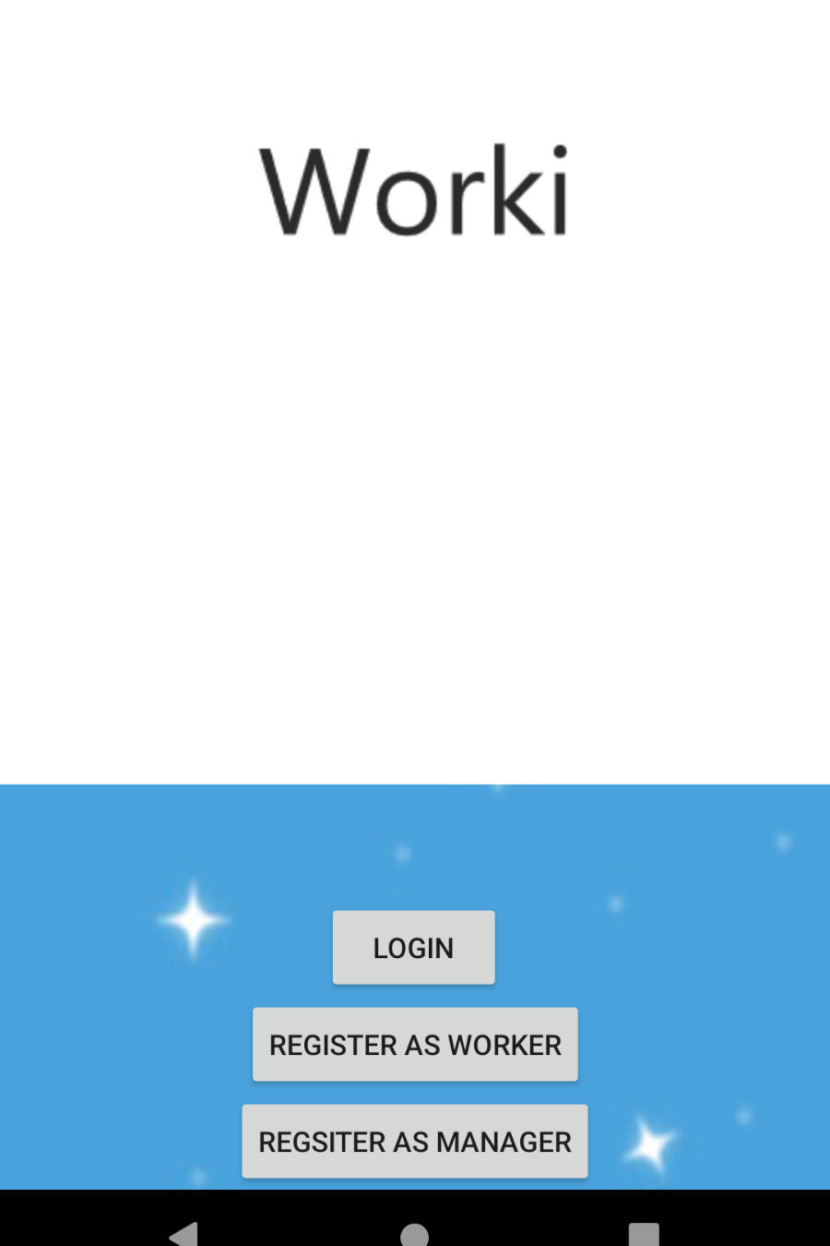
Regisiter- in page
By E-mail & Password

Slide 5
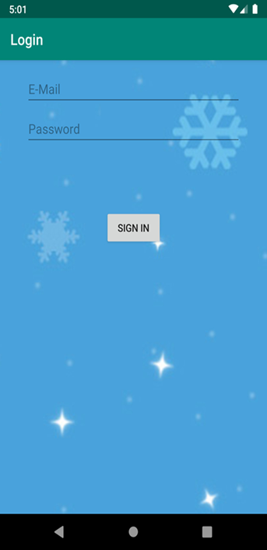
Log- in page
By E-mail & Password

Slide 6

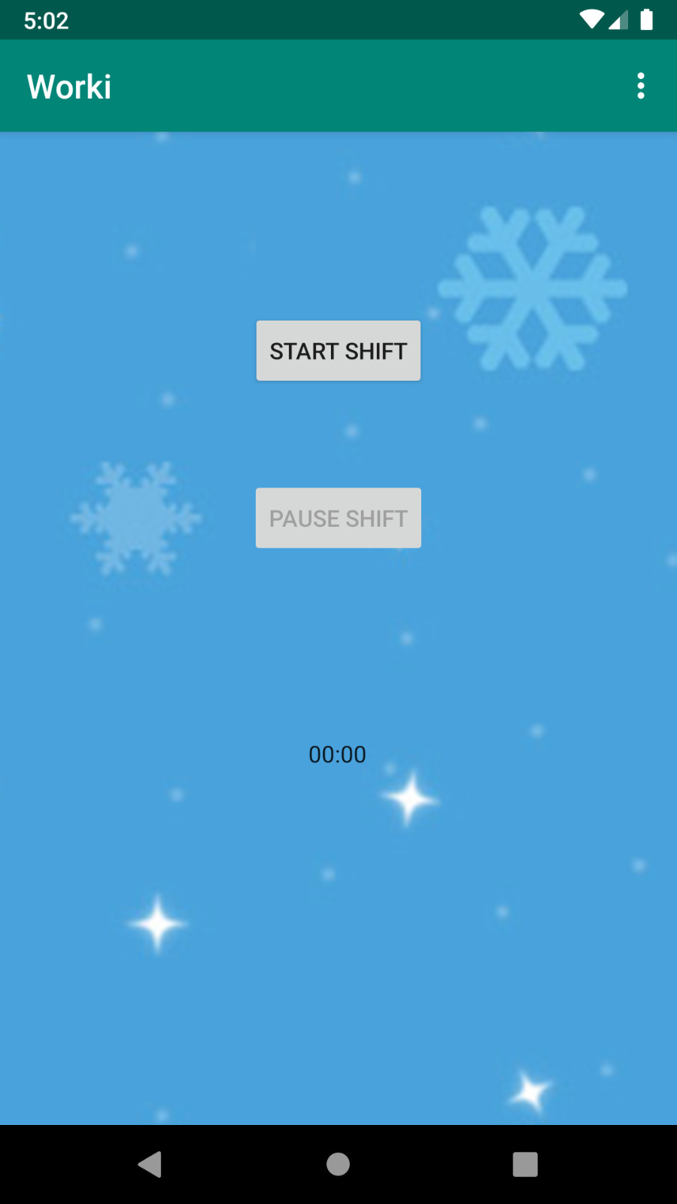
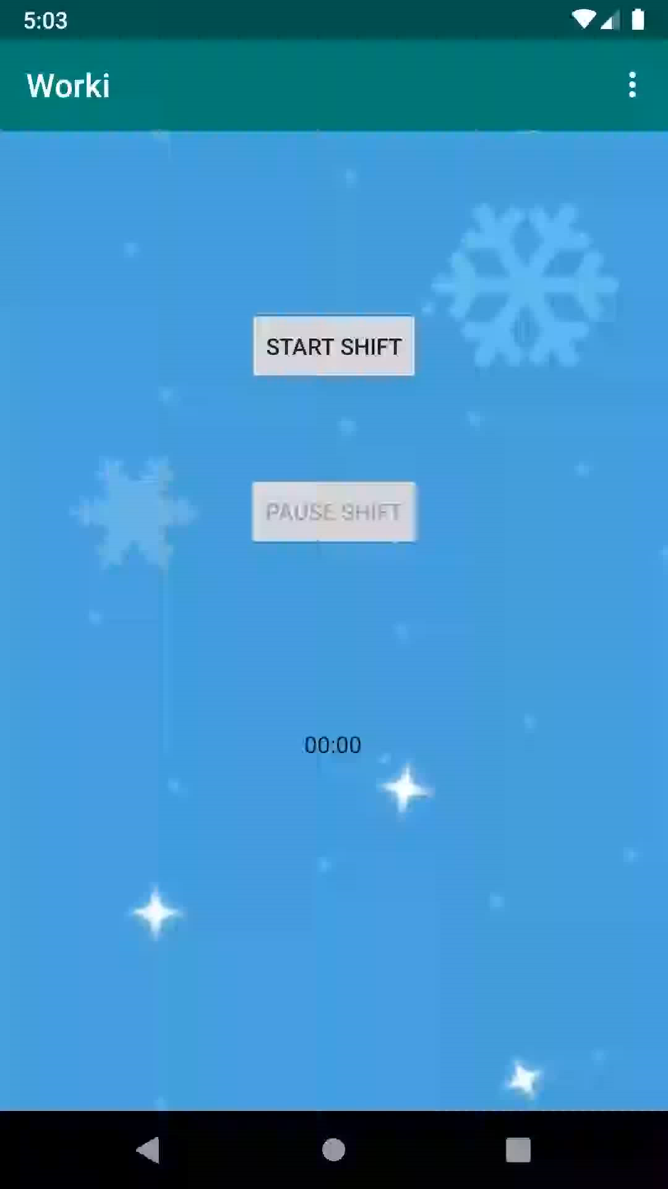
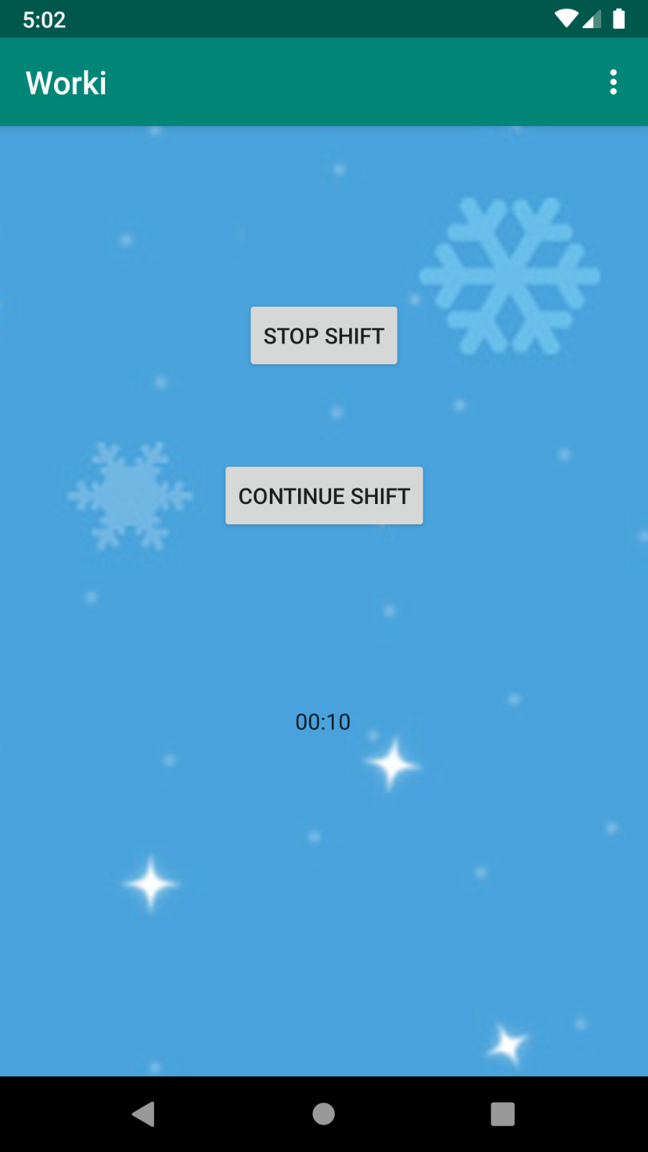
Timer for each Shift
With the option to start/pause/continue/stop the shift

Slide 7
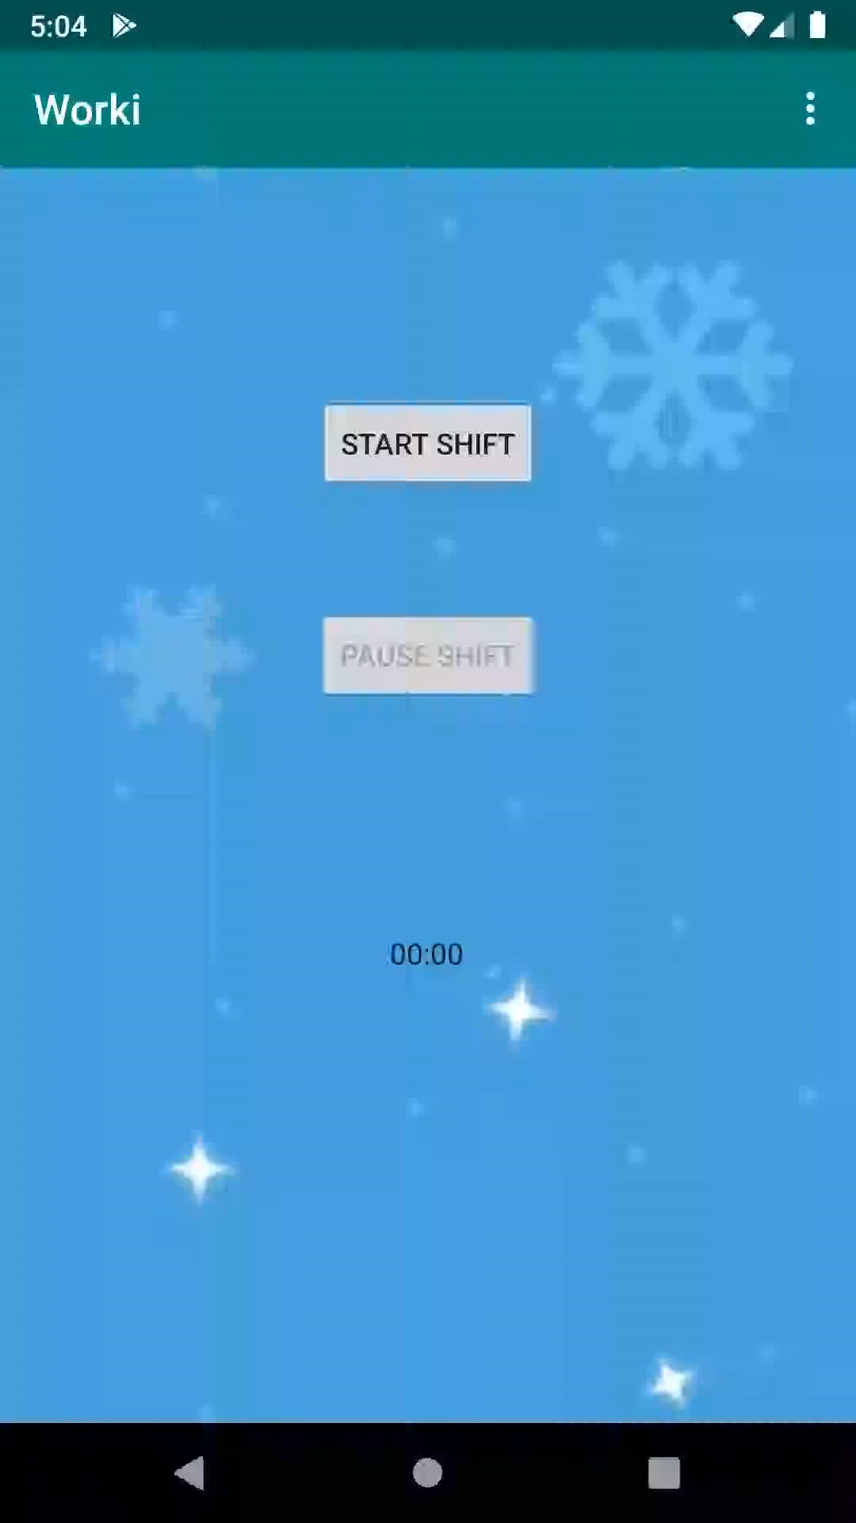
The manager will always have the option of adding a worker by adding his E-mail adress .

Slide 8
Unified Modeling Language Diagrams:

Slide 9
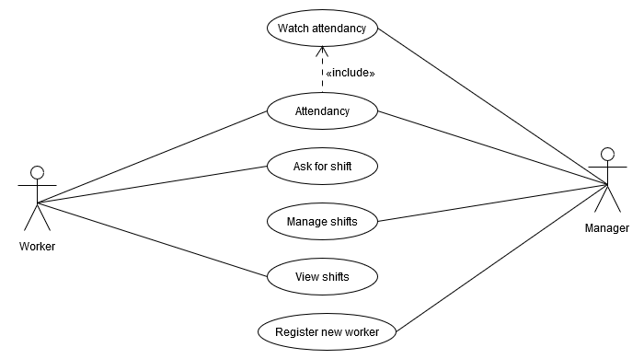
Worki use-case diagram

Slide 10
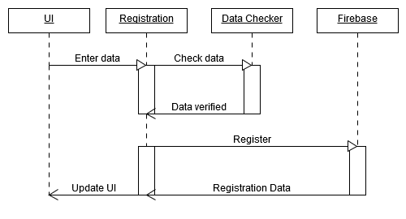
Worki Sequence diagram

Slide 11
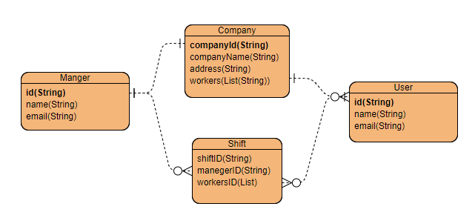
Worki-Entity Relationship Diagram

Slide 13
Link for Github: https://github.com/elishadar/Worki

